Slide 1
Statistics Masters Workshop Statistics Intro
Nick Rasmussen
3/12/2021

Slide 2

How do I choose a statistical test?
Non-parametric
Generalized mixed effects models
Logistic regression
Bayesian statistics
Chi-square test
ANOVA
Multiple regression
Markov chain Monte Carlo
Homogeneity of variances

Slide 3
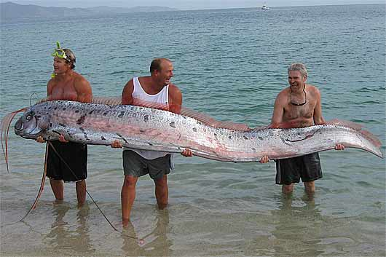
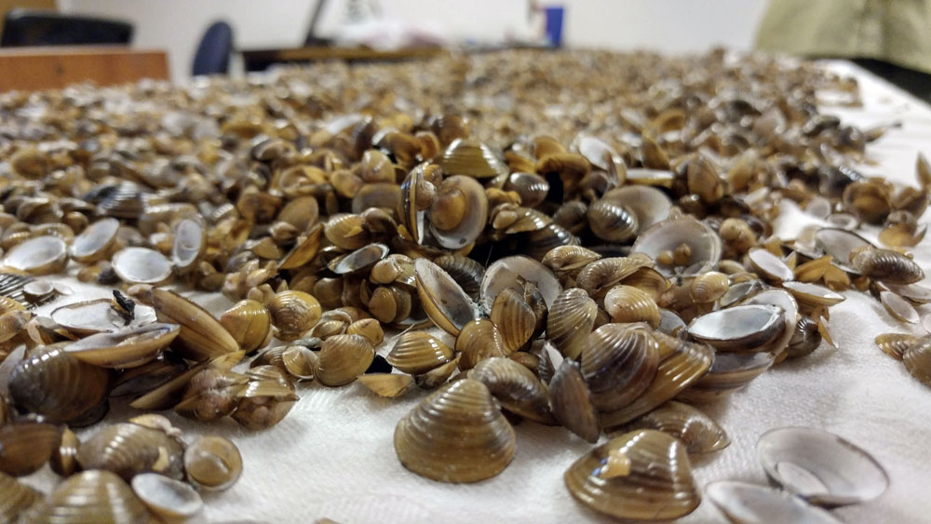
Start by identifying your data types
Quantitative variables
Continuous: data that can be divided into smaller units than one
Water temperature
Fish length
Discrete: data that cannot be subdivided into smaller units
Species of phytoplankton
Number of clams

Slide 4
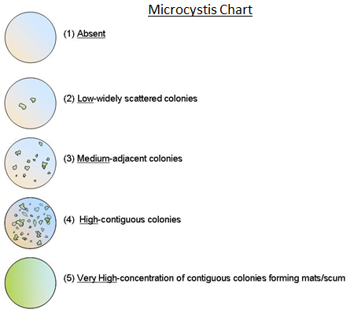

Start by identifying your data types
Categorical variables
Ordinal: represent data with an order
Microcystis abundance scores
Nominal: represent group names
Sampling station
Binary: represent data with two outcomes
Fish alive or dead

Slide 5


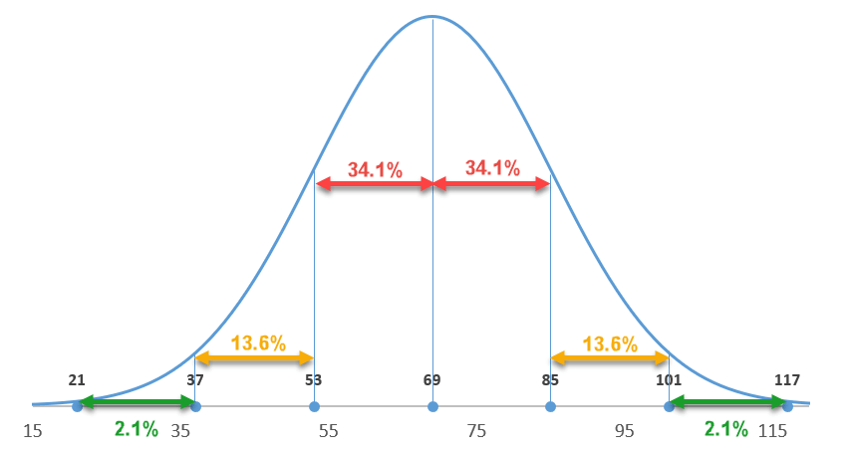
Are the data normally distributed?
This only applies to the quantitative response variables
If the distribution of the data approximate a bell curve, then use parametric statistics
If not normally distributed, then non-parametric statistics may be the best option

Slide 6
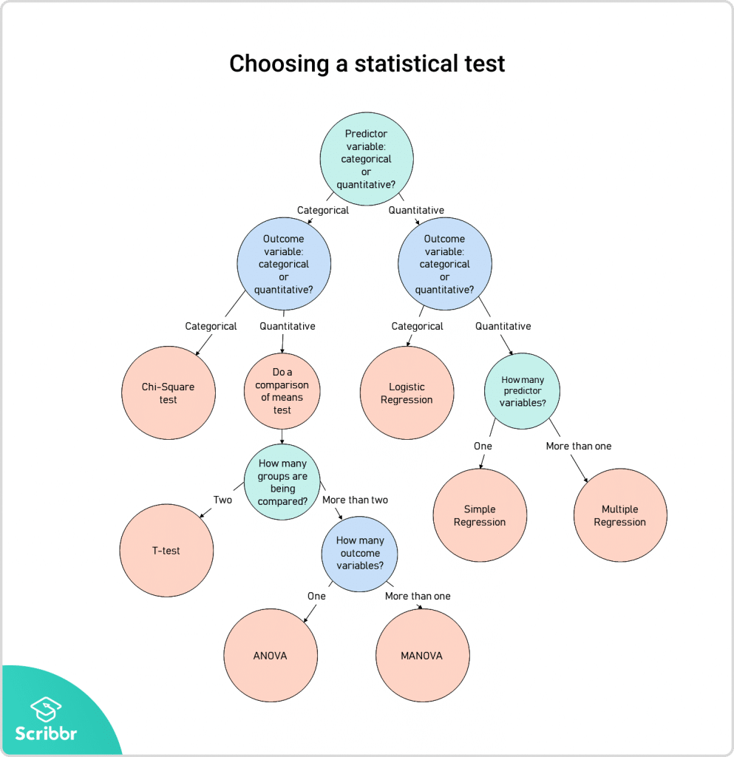
This is just the parametric tests, but an analogous flow chart could be made for non-parametric tests

Slide 7
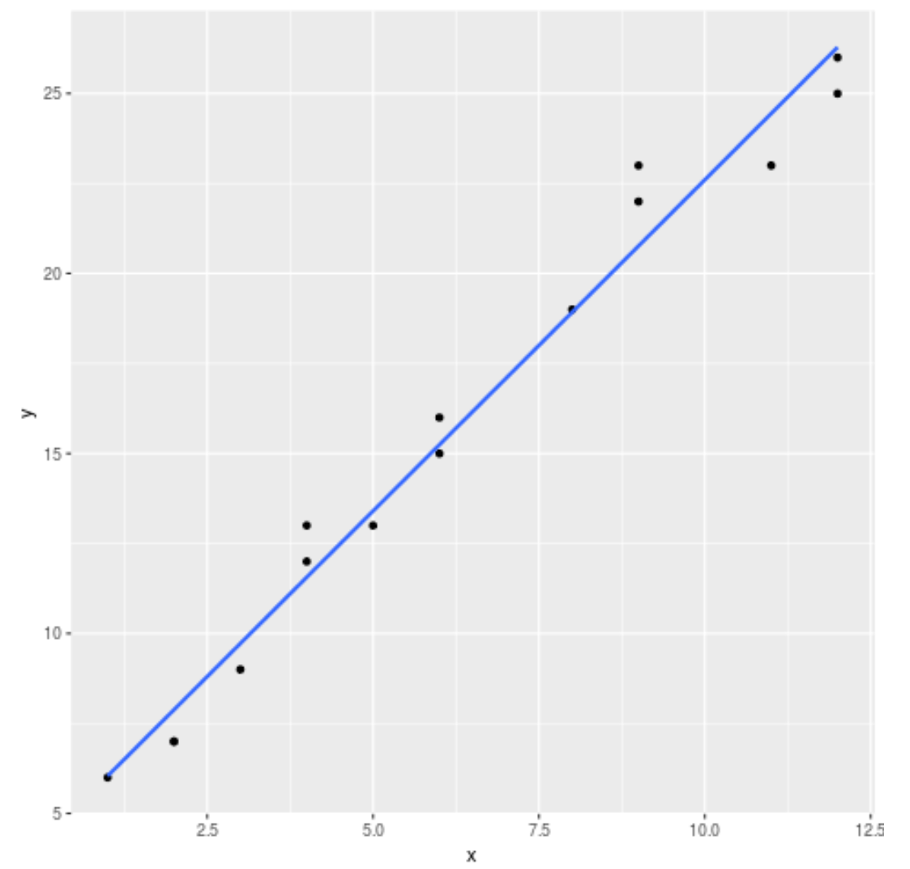


Turbidity was measured to determine how it affected the biomass of aquatic weeds.
Predictor: Turbidity
Response: weed biomass
Quantitative, continuous
Quantitative, continuous

Slide 8
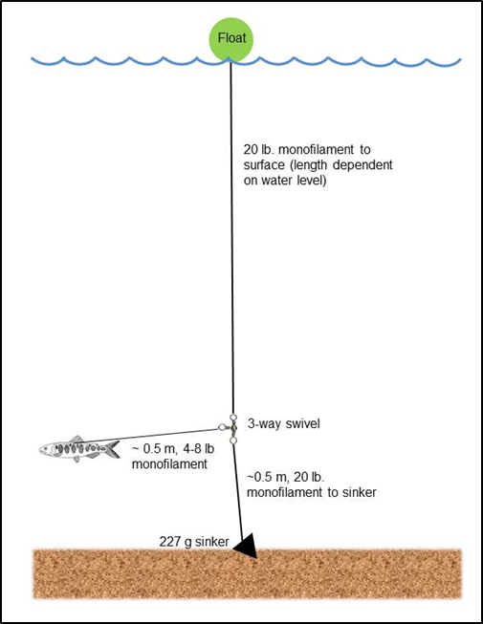

Salmon parr of different sizes were tethered in the Delta to determine how body size affected whether they were eaten or not.
Predictor: Parr size
Response: # of survivors
Quantitative, continuous
Categorical, binary

Slide 9
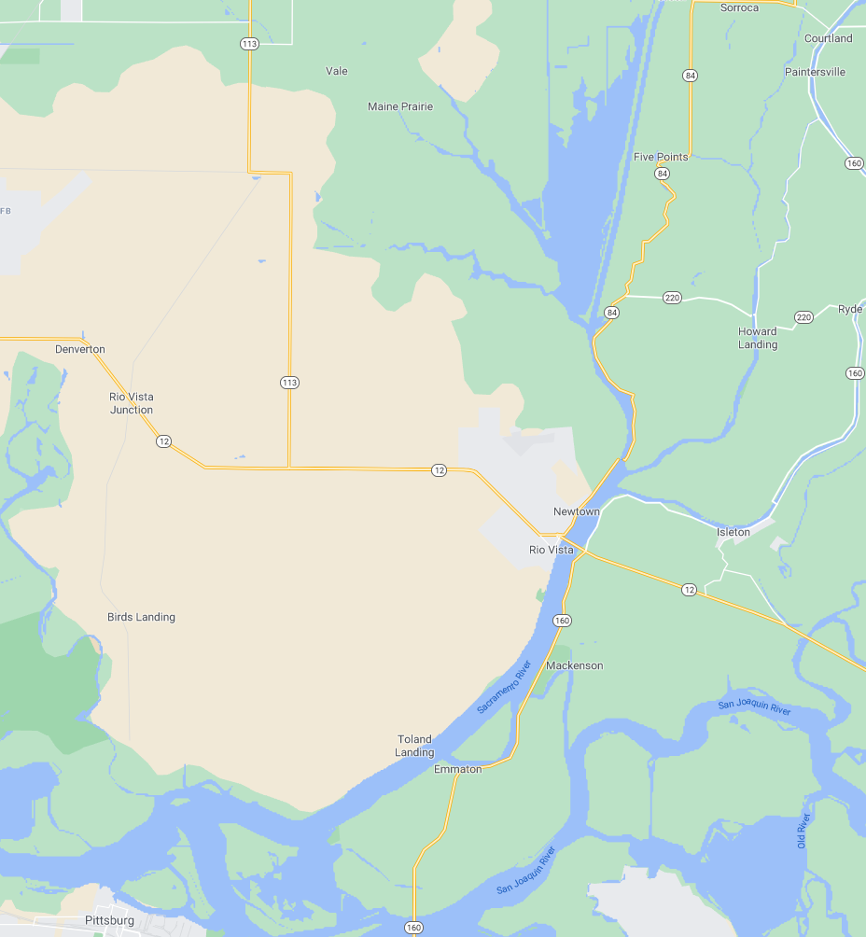

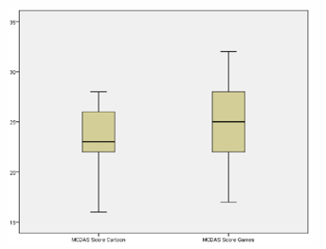
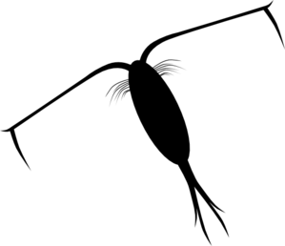
Zooplankton was sampled in the North Delta and the West Delta to determine where zooplankton densities were higher.
Predictor: Delta Region
Response: zooplankton density
Categorical, nominal
Quantitative, continuous

